Slide 1
Ch.1 Terahertz Time-Domain Spectrometer
Lee Jong Geon

Slide 2
Contents
Pulsed Terahertz Time-Domain Spectrometers
Time-Domain Spectrometer Configurations

Slide 3
Pulsed Terahertz
Time-Domain Spectrometers

Slide 4
1.1 Principles of Operation
Single-cycle
optical pusle
Terhertz beam
➔ Coherent and Broadband
Closed-loop
pump-probe
configuration
High signal-to-noise ratio
and the Dynamic range

Slide 5
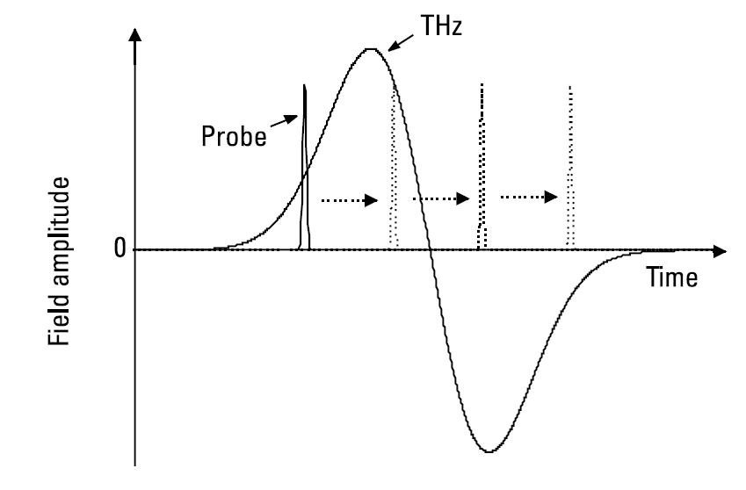

1.1 Principles of Operation
As short as possible
$$Signal\left(t_{0}\right) ∝ \int_{−∞}^{∞}{I_{probe}\left(t−t_{0}\right)E_{THz}\left(t\right)dt}$$

Slide 6
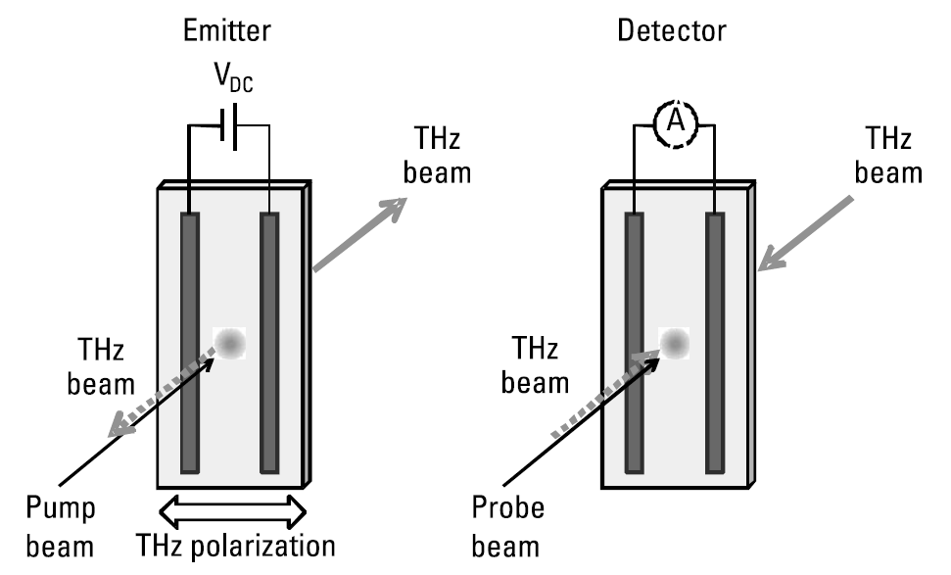


1.2 Photoconductive Emitters and Detectors
Ti-sapphire (800nm) ➔ 1.55ev
GaAs ➔ 1.42eV
-> generate carriers
$$E_{THz}\left(r,t\right)=\frac{l_{e}}{4πε_{0}c^{2}r}\frac{∂J\left(t\right)}{∂t}\sin{θ} ∝\frac{∂J(t)}{∂t}$$
$$J_{PC}=q_{C}N_{C}v_{C} ∝I_{opt}V_{DC}$$

Slide 7
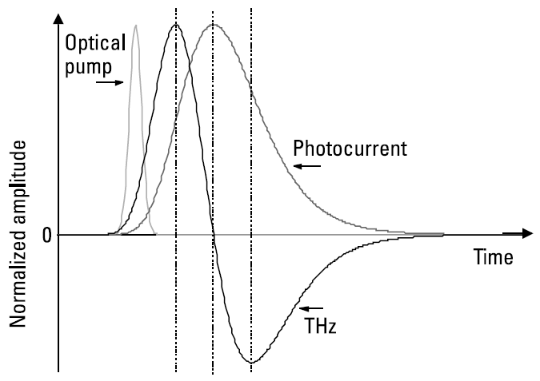
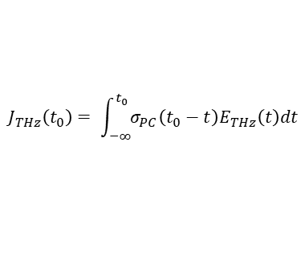
1.2 Photoconductive Emitters and Detectors
The rise time of the photocurrent: the pump laser pulse length
The fall time of the photocurrent: 1. the pulse length, 2. the semiconductor carrier lifetime, and 3. the time it takes for carrier to be swept out of the active region by the bias field
Emitter material
$$J_{THz}\left(t_{0}\right)= \int_{−∞}^{t_{0}}{σ_{PC}\left(t_{0}−t\right)E_{THz}\left(t\right)dt}$$
Mira
Sakai
Large optical absorption coefficient
High optical damage threshold
High breakdown voltage
Subpicosecond carrier lifetime
Relativity high carrier mobility
High breakdown fileds

Slide 8
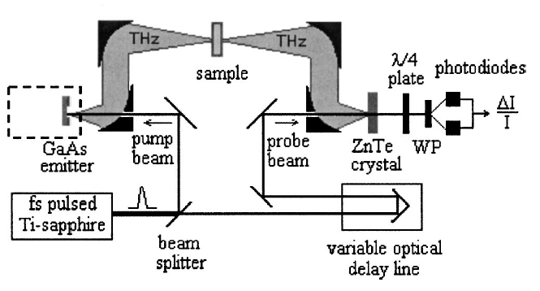
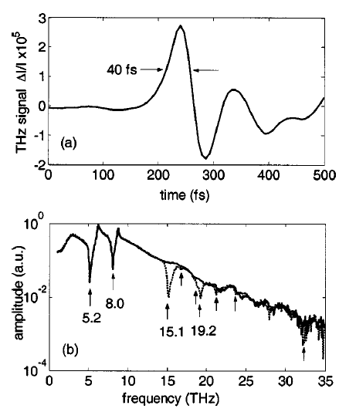
1.2 Photoconductive Emitters and Detectors
ZnTe detector
(TO phonon energy: 22 meV = 5.2THz)
LT-GaAs
➔ (TO phonon energy: 33 meV = 8.0THz)
Shen, Y. C., et al., “Ultrabroadband Terahertz Radiation from Low-Termperature-Grown GaAs Photoconductive Emitters,” Appl. Phys. Lett., Vol. 83, 2003.

Slide 9
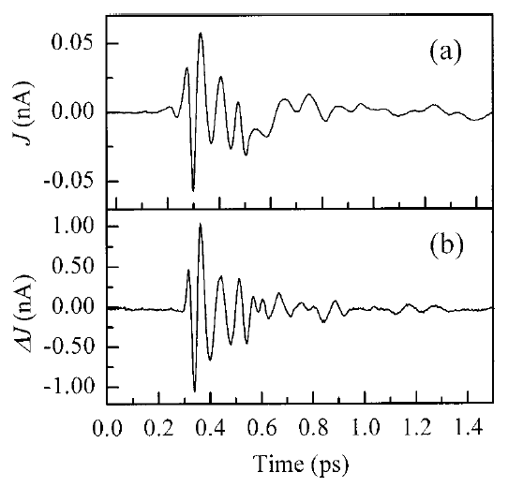
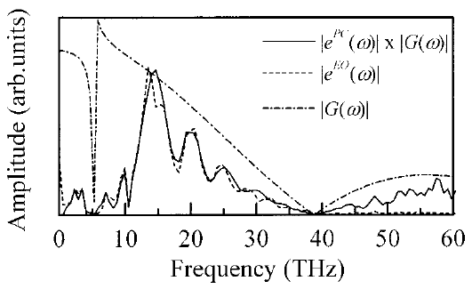


1.3 Optical Rectification
$$L_{max} ≤\frac{ct_{pump}}{n_{THz}−n_{pump}}$$
$$L_{max}$$
Non-linear crystal: ZnTe crystal
Absortion (phonon): 5.3, 3.5, 1.5 THz
(TI-sapphire, 800nm)
fs laser
THz pulse
Non-linear crystal
Kono, S., M. Tani, and K. Sakai, “Ultrabroadabnd Photoconductive Detection: Comparison with Free-SpaceElectro-Optic Sampling,” Appl. Phys. Lett., Vol. 79, 2001.

Slide 10
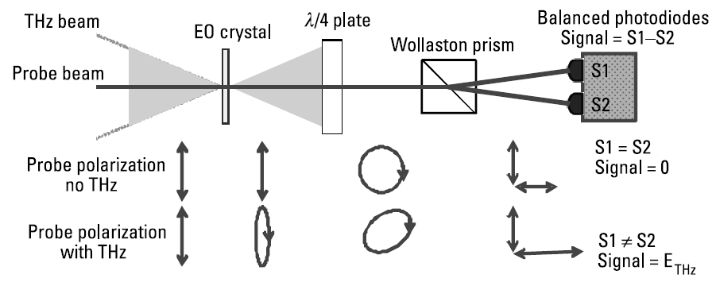


1.4 Electro-Optic Detection
Electro-optic detection relies on the Pockels effect where an electric field gives rise to birefringence in an optical material.
$$\frac{∆I}{I}=\frac{1}{2}\left(1+\sin{∆φ}\right)−\frac{1}{2}\left(1−\sin{∆φ}\right)=\sin{∆φ} ≈∆φ$$
$$∆φ=\frac{2πL}{λ_{probe}} n_{probe}^{3}r_{eff}E_{THz}$$
Advantages
Easier alignment, lower sensitivity to probe beam pointing
No need microfabricated highly specialized semiconductor device
Simpler electronics

Slide 11
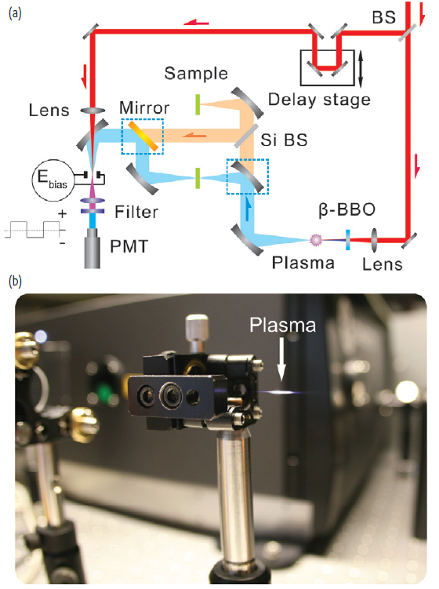

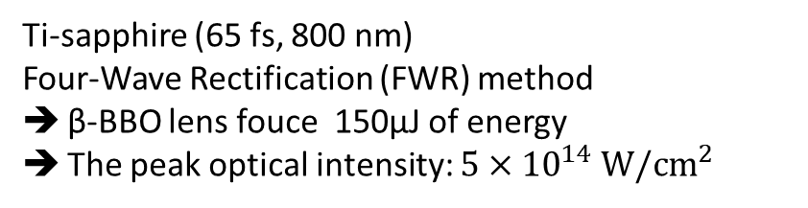

1.5 Terahertz Air-Based Coherent Detection
Terahertz air-based coherent detection (THz-ABCD) uses ionized air as a medium for ultra-broadband terahertz generation and detection
$$E_{THz} ∝χ^{\left(3\right)}E_{ω}^{2}E_{2ω}$$
$$I_{2ω}\left(t_{0}\right)∝2{\left[χ^{\left(3\right)}E_{ω}^{2}\left(t\right)\right]}^{2}E_{bias}E_{THz}\left(t−t_{0}\right)$$
➔ 3-order optical nonlinearlity in plasma
Ti-sapphire (65 fs, 800 nm)
Four-Wave Rectification (FWR) method
β-BBO lens fouce 150µJ of energy
The peak optical intensity: $5×{10}^{14} W/cm^{2}$
Clough, B., J. Dai, and X. –C. Zhang, “Laser Air Photonics: Beyond the Terahertz Gap,” Mater. Today, Vol. 15, 2012.
D. J. Cook and R. M. Hochstrasser, "Intense terahertz pulses by four-wave rectification in air," Opt. Lett. 25, 1210-1212 (2000)

Slide 12
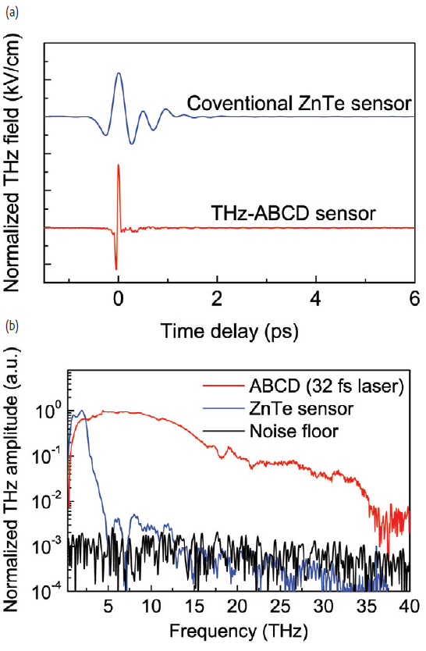
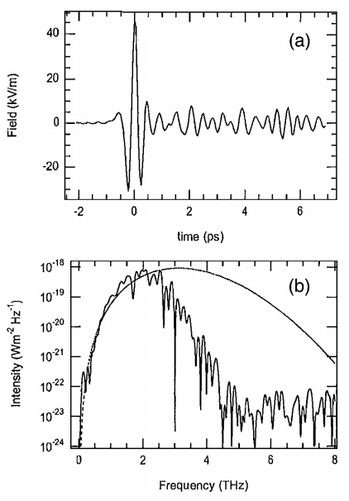
1.5 Terahertz Air-Based Coherent Detection
The requirement for an amplified ultrafast laser as a pump source and issues arising from working with plasma
Clough, B., J. Dai, and X. –C. Zhang, “Laser Air Photonics: Beyond the Terahertz Gap,” Mater. Today, Vol. 15, 2012.
D. J. Cook and R. M. Hochstrasser, "Intense terahertz pulses by four-wave rectification in air," Opt. Lett. 25, 1210-1212 (2000)

Slide 13
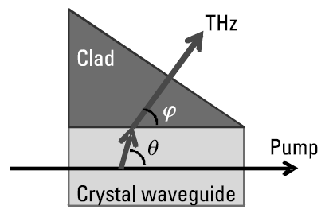
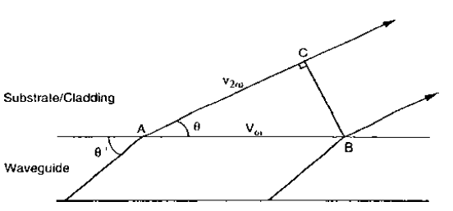
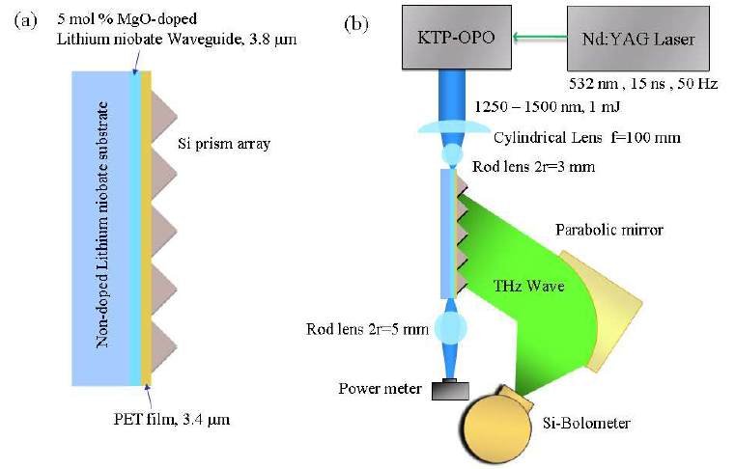
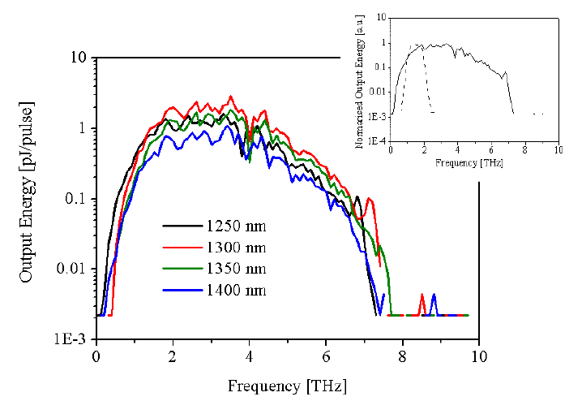

1.6 Cherenkov Emitters and Detectors
$$\cos{θ}=\frac{V_{ω}}{v_{2ω}}= \frac{n_{pump}}{n_{THz}}$$
Suizu, K., et al., “Extremely Frequency-Widened Terahertz Wave Generation Using Cherenkov-Type radiation,” Opt. Exp., Vol. 17, 2009.
Sutherland, R. L., Handbook of Nonlinear Optics, New York: Marcel Dekker, 2003, pp. 91-95.

Slide 14
Time-Domain Spectrometer
Configurations

Slide 15
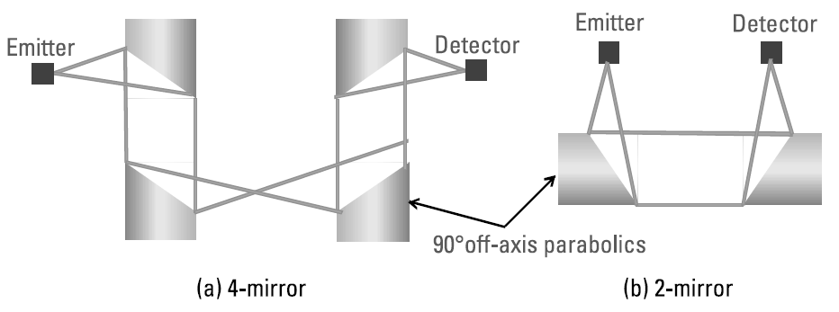
2.1 Transmission
The great majority of Terhertz TDS system
A more accurate and precise measure of attenuation and phase shift
Using off-axis parabolic mirrors

Slide 16
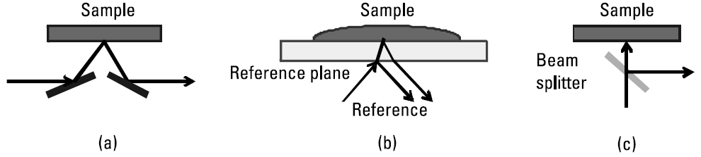
2.2 Reflection
Opaque materials (a)
Liquid materials (b) ➔ need great care to avoid air gaps
Normal incidence (c) ➔ the incurred loss of terahertz power is a least 75%

Slide 17
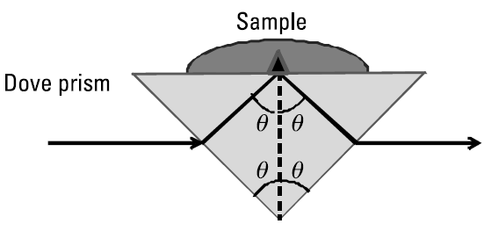
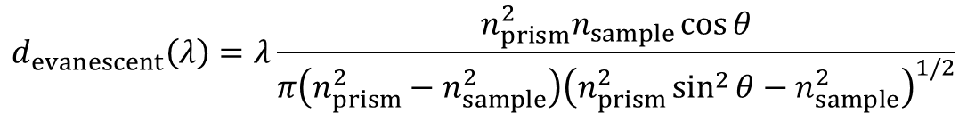

2.3 Attenuated Total Reflection
Attenuated Total Reflection (ATR) relies on total internal reflection at an interface, which is modified (attenuated) by the interaction of the evanescent wave with the material of the sample
$$\sin{θ}=n_{prism}\sin\left(2θ−\frac{π}{2}\right)$$
$$d_{evanescent}\left(λ\right)=λ\frac{n_{prism}^{2}n_{sample}\cos{θ}}{π\left(n_{prism}^{2}−n_{sample}^{2}\right){\left(n_{prism}^{2}\sin^{2}{θ}−n_{sample}^{2}\right)}^{1/2}}$$

Slide 18
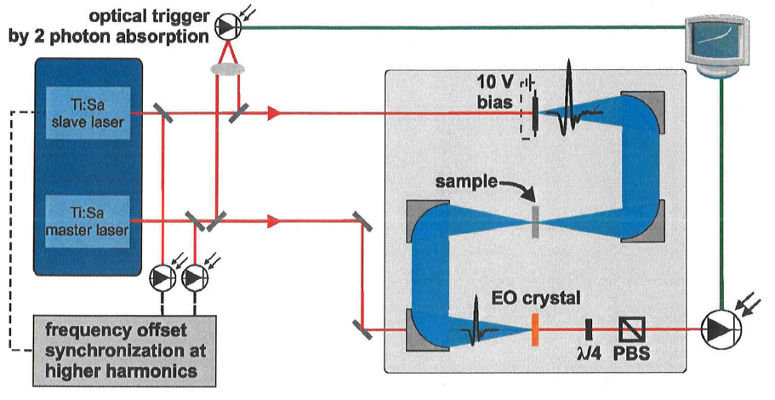
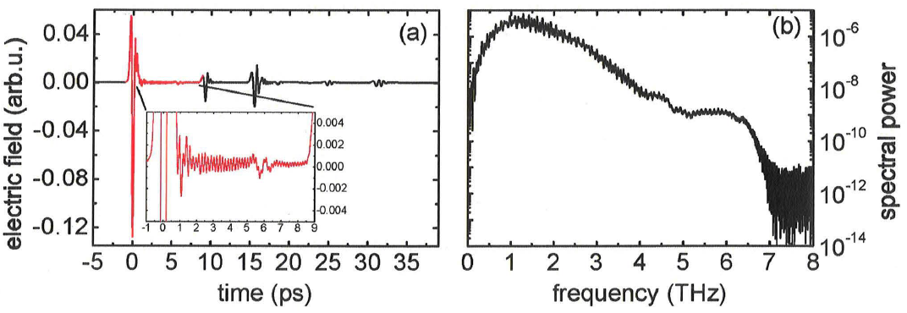
2.4 Asynchronous Optical Sampling
Klatt, G., et al., “High-Resolution Terahertz Spectrometer,” IEEE J. Se. Top. Quant. Electron., Vol. 17, 2011.

Slide 19
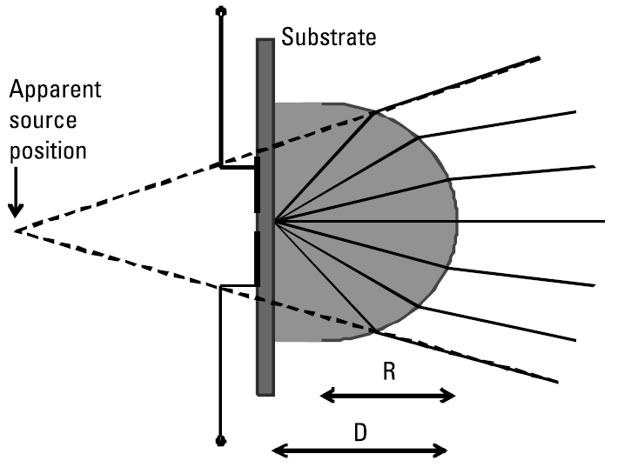
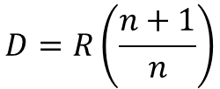
2.5 Substrate Lenses
$$D=R\left(\frac{n+1}{n}\right)$$

Slide 20
References
Clough, B., J. Dai, and X. –C. Zhang, “Laser Air Photonics: Beyond the Terahertz Gap,” Mater. Today, Vol. 15, 2012, pp. 50-58
D. J. Cook and R. M. Hochstrasser, "Intense terahertz pulses by four-wave rectification in air," Opt. Lett. 25, 1210-1212 (2000)
Klatt, G., et al., “High-Resolution Terahertz Spectrometer,” IEEE J. Se. Top. Quant. Electron., Vol. 17, 2011, pp. 159-168.
Kono, S., M. Tani, and K. Sakai, “Ultrabroadabnd Photoconductive Detection: Comparison with Free-SpaceElectro-Optic Sampling,” Appl. Phys. Lett., Vol. 79, 2001, pp.898-900.
Shen, Y. C., et al., “Ultrabroadband Terahertz Radiation from Low-Termperature-Grown GaAs Photoconductive Emitters,” Appl. Phys. Lett., Vol. 83, 2003, pp. 3117-3119
Suizu, K., et al., “Extremely Frequency-Widened Terahertz Wave Generation Using Cherenkov-Type radiation,” Opt. Exp., Vol. 17, 2009, pp. 6676-6681.
Sutherland, R. L., Handbook of Nonlinear Optics, New York: Marcel Dekker, 2003

